Slide 1
Blooms Taxonomy

Slide 2
Different Levels of Learning?
How do you know what you know?
Why do you know some things better than others?
Why do some people know different things than you?
What is “true” understanding?
Do believe there are different levels of understanding? Explain?

Slide 3
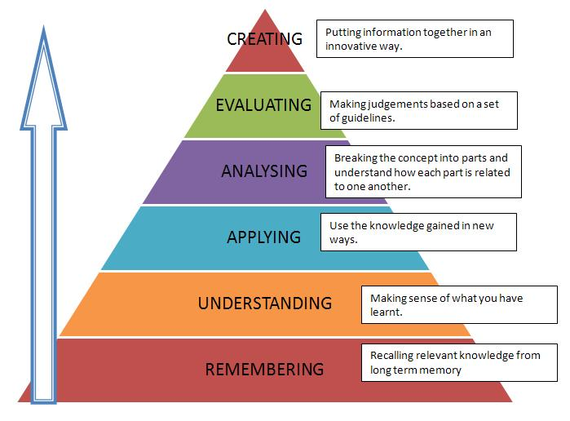

Slide 4
Bloom’s Taxonomy of Six Cognitive Levels
Level 1: Knowledge/Remembering A starting point that includes both the acquisition of information and the ability to recall information when needed.
A. Classifying B. Distinguishing opinion from fact C. Giving definitions and examples D. Outlining and summarizing

Slide 5
Bloom’s Taxonomy of Six Cognitive Levels
Level 2: Comprehension/Understanding The basic level of understanding. It involves the ability to know what is being communicated in order to make use of the information.
A. Making comparisons B. Identifying structure C. Ordering steps in a process D. Reading charts and graphs E. Recognizing meaning F. Identifying main ideas G. Identifying relationships

Slide 6
Bloom’s Taxonomy of Six Cognitive Levels
Level 3: Application/Applying The ability to use a learned skill in a new situation.
A. Estimating B. Anticipating probabilities C. Making inferences D. Applying math

Slide 7
Bloom’s Taxonomy of Six Cognitive Levels
Level 4: Analysis/Analyzing The ability to break down information into its integral parts and to identify the relationship of each part of the total organization.
A. Judging completeness B. Recognizing relevance & irrelevance C. Identifying story elements D. Judging sentence sequence E. Recognizing fallacies

Slide 8
Bloom’s Taxonomy of Six Cognitive Levels
Level 5 (6): Evaluation/Evaluating
The ability to make a judgment about the value of something by using a standard.
A. Making generalizations B. Developing criteria C. Judging accuracy D. Making decisions E. Identifying values F. Identifying the mood of a story

Slide 9
Bloom’s Taxonomy of Six Cognitive Levels
Level 6 (5): Synthesis/Creating The ability to combine existing elements in order to create something original.
A. Communicating ideas B. Planning projects
C. Forming hypotheses D. Drawing conclusions

Slide 10
Bloom's Taxonomy Verbs
1 | 2 | 3
list name identify show define recognize recall state | summarize explain put into your own words interpret describe compare paraphrase differentiate demonstrate visualize find more information about restate | solve illustrate calculate use interpret relate manipulate apply classify modify put into practice
4 | 5 | 6
analyze organize deduce choose contrast compare distinguish | design hypothesize support schematize write report discuss plan devise compare create construct | evaluate choose estimate judge defend criticize justify

Slide 11
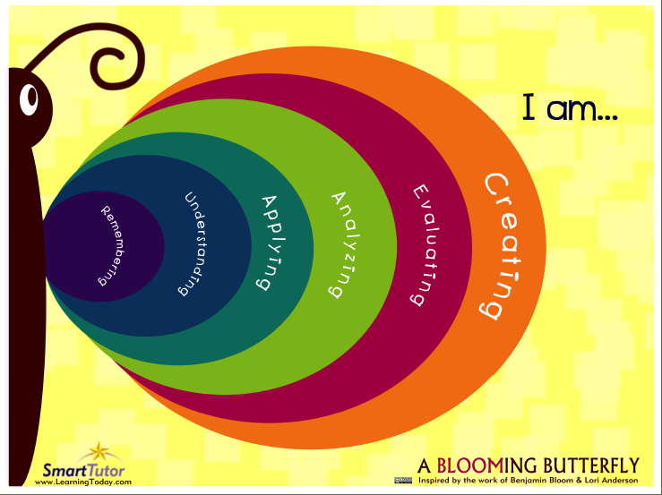
Now it is your turn…..

